Slide 1
Final presentation “You Free?”
Team Solo Malcolm Brown

Slide 2
Introduction
“You Free?”
The matchmaking app for bored students

Slide 3
Design problem
Target Audience = Students with smartphones
Stakeholders = None really beyond audience, monetize it someday?

Slide 4
User research
2 Methods
Secondary Research
Survey

Slide 5
User research
Results
People don’t really look at photos past the first
Meeting in person is better than the in-app messenger

Slide 6
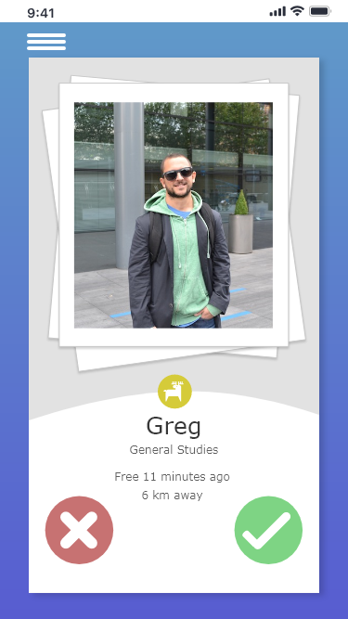
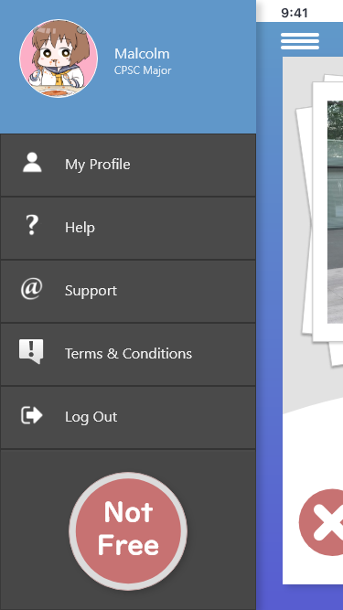
Design Justifications
Sandwich Menu accessible from nearly all pages
Minimum of 3 choices per view
Right side = positive, Left side = negative

Slide 7
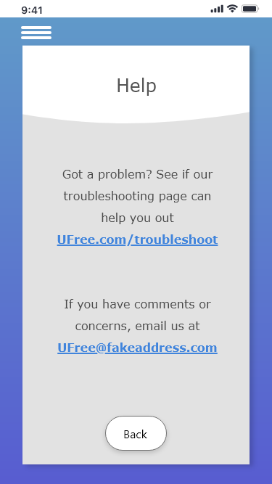
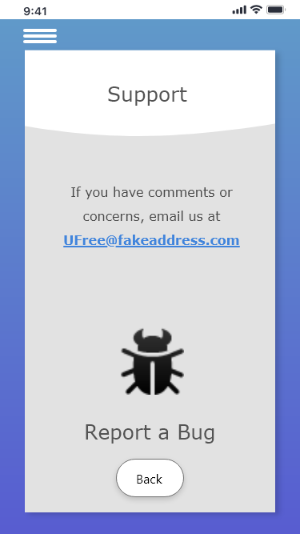
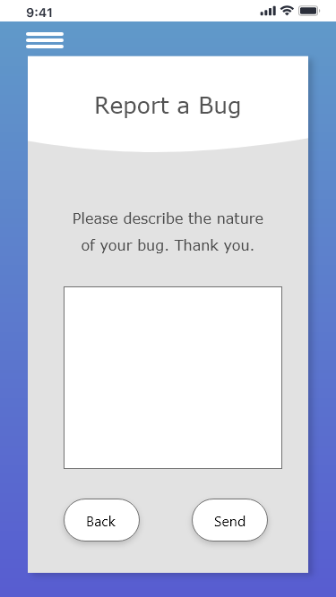
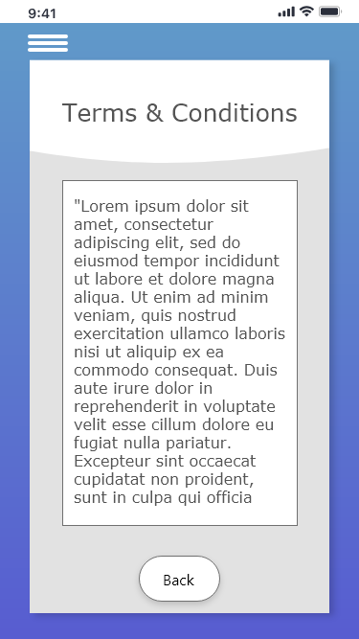
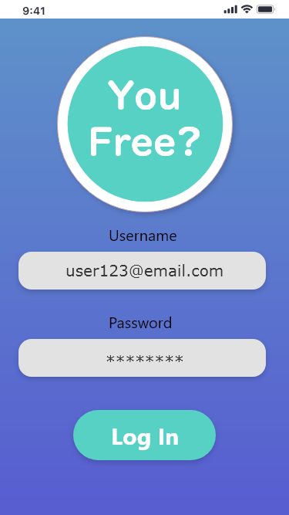
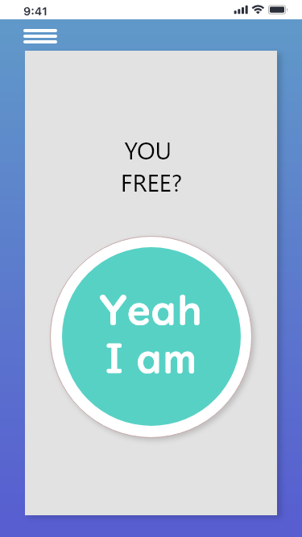
Heuristic testing the good
Minimalist Design
No Code Yet, So No Errors
No Load Times
Explicit Help Menus

Slide 8
Heuristic testing the Bad
No Error Recovery
No Safety Nets for Errors
(Accidental log out)

Slide 9
Test user Validity
Target Audience = University Students
Where to find 5+ University Students?

Slide 10
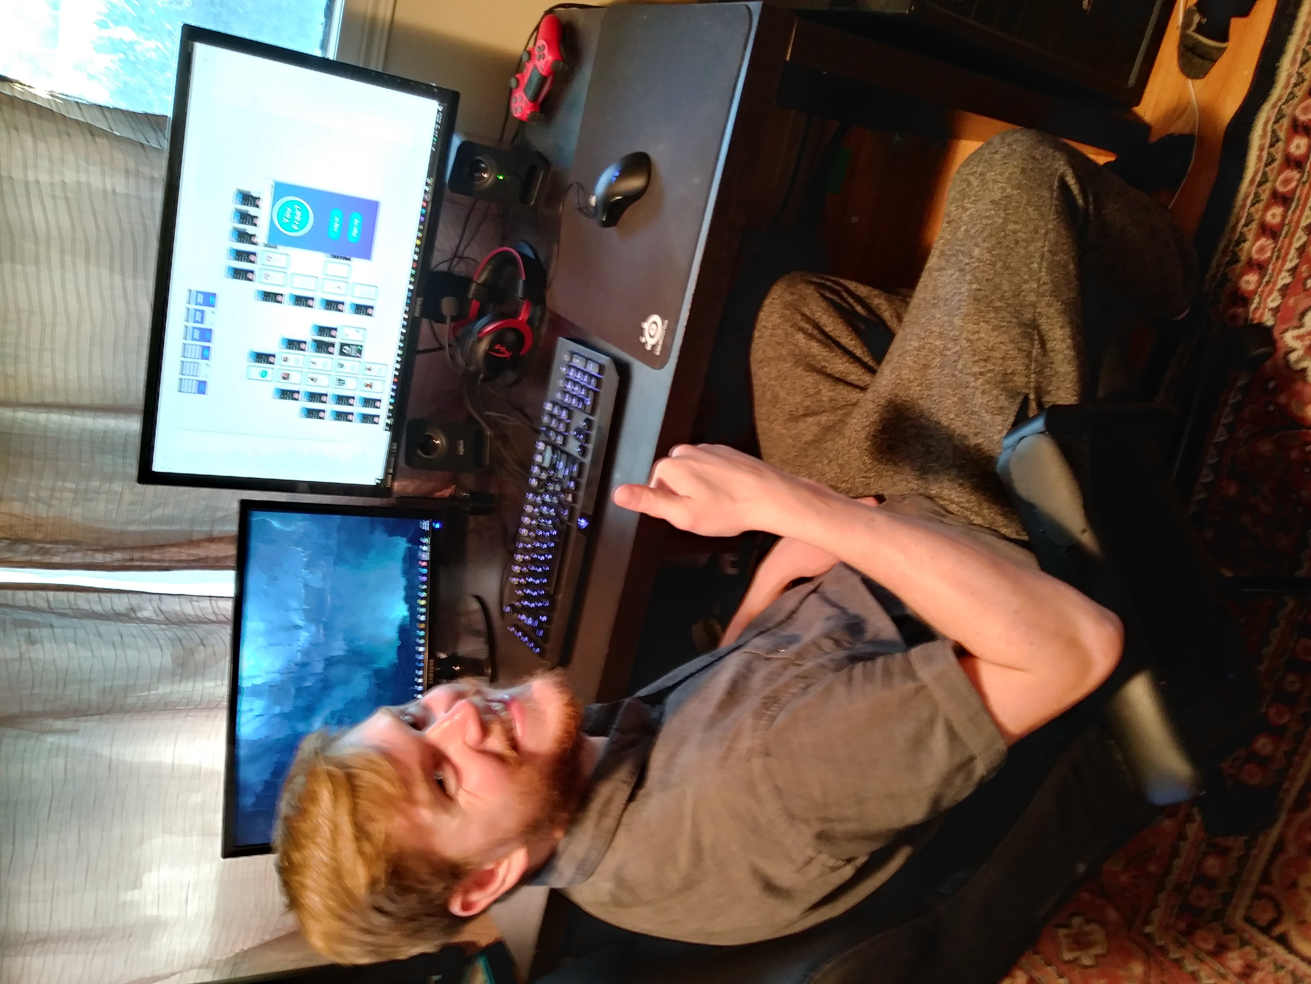
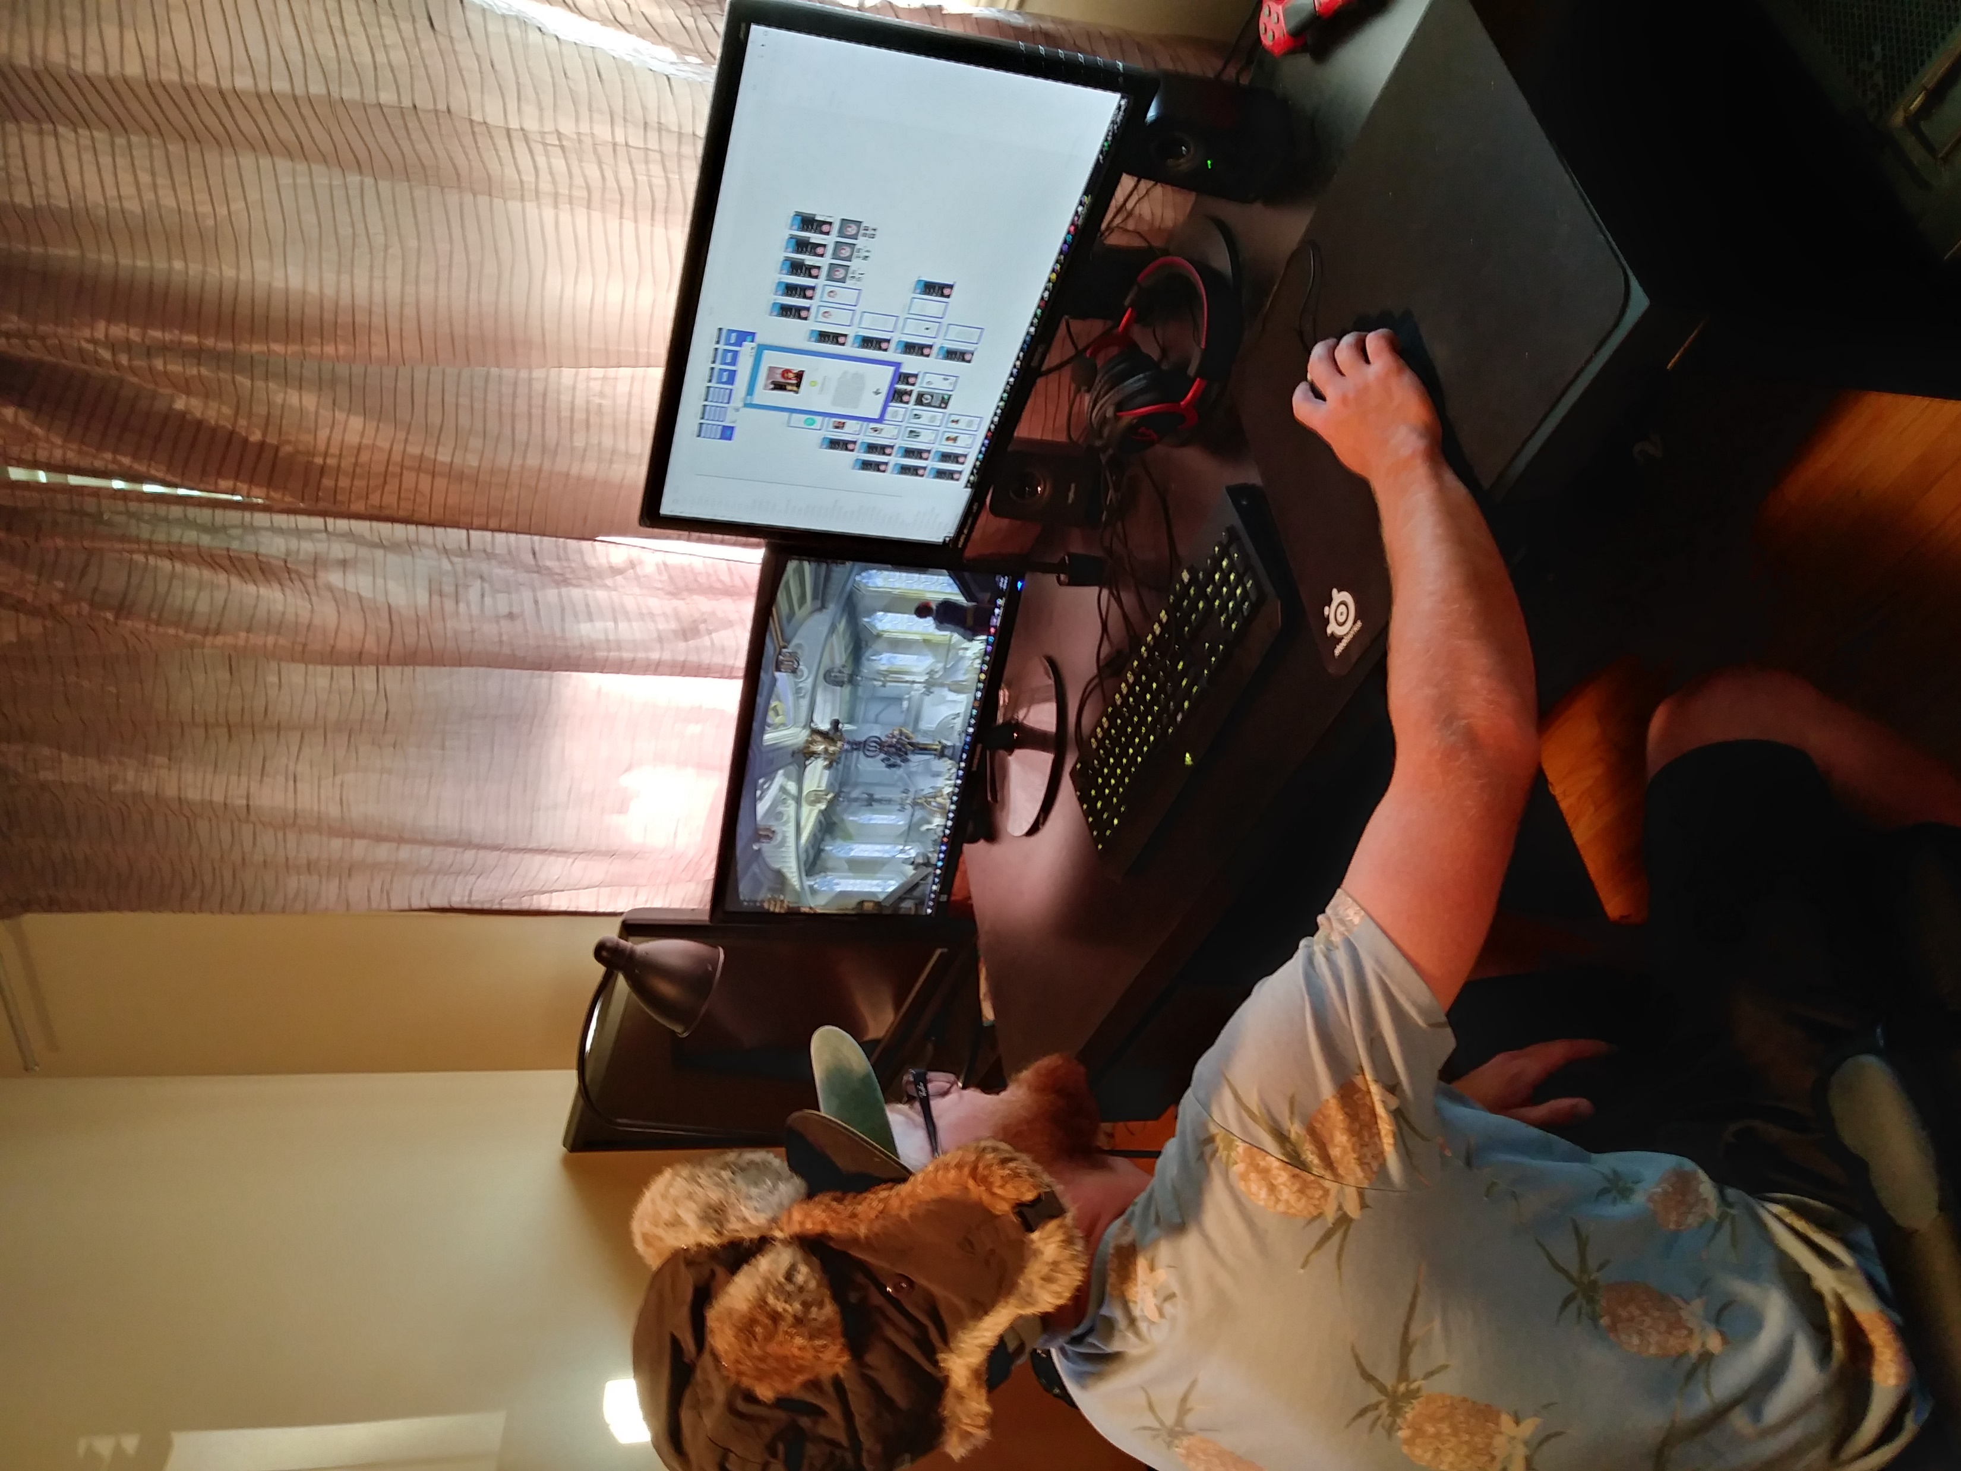
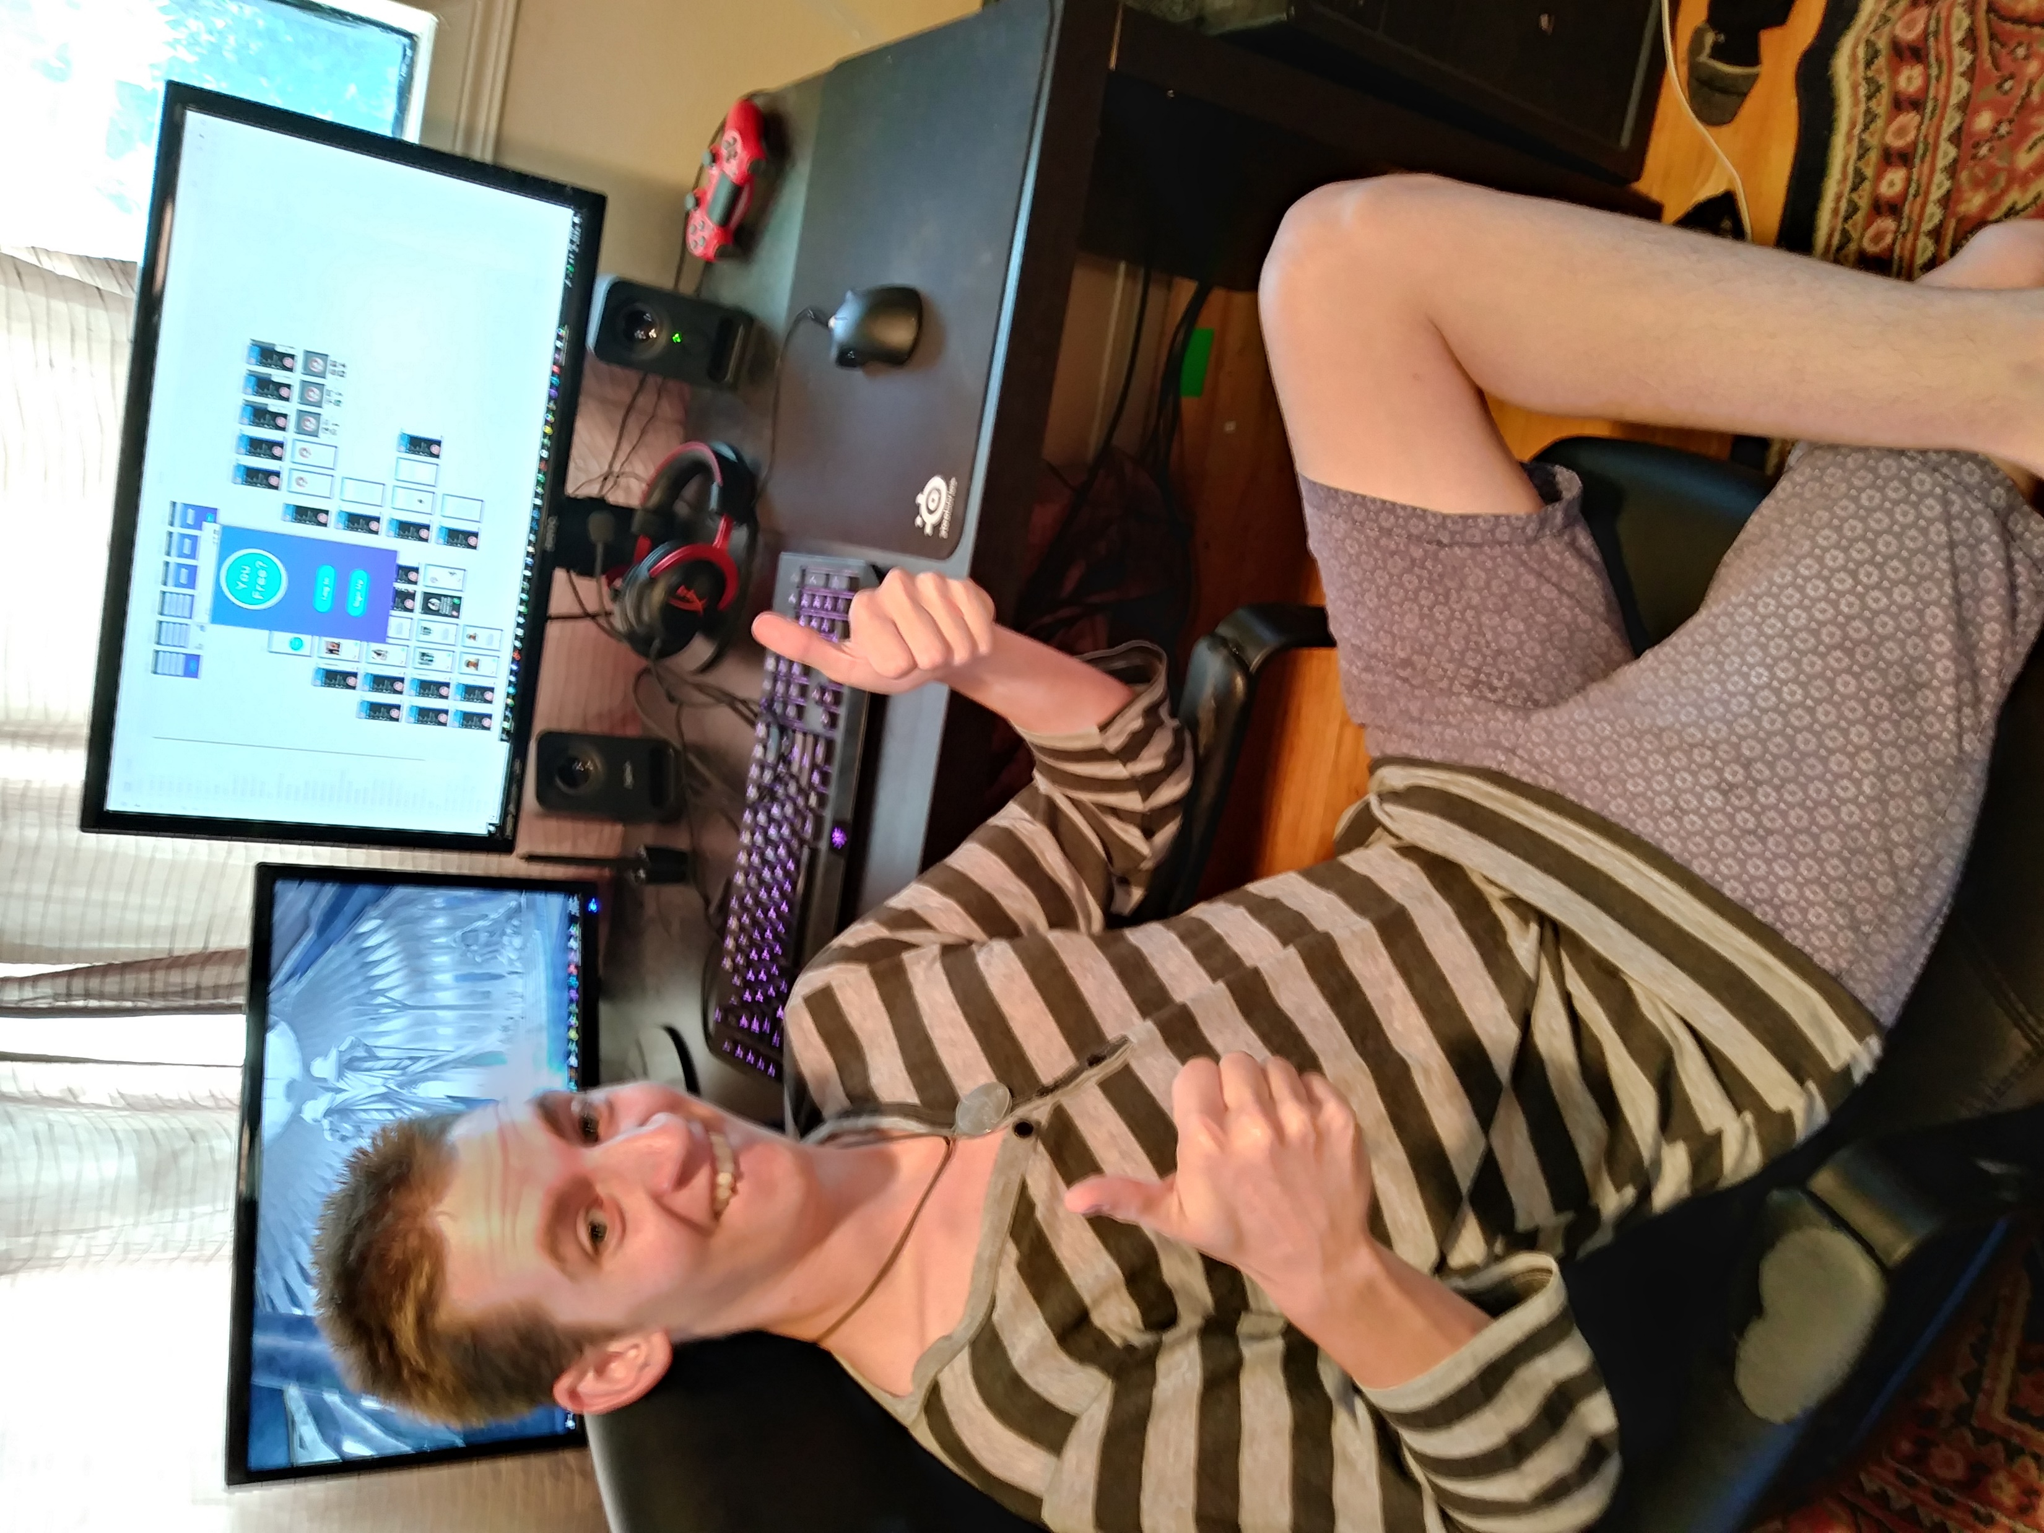
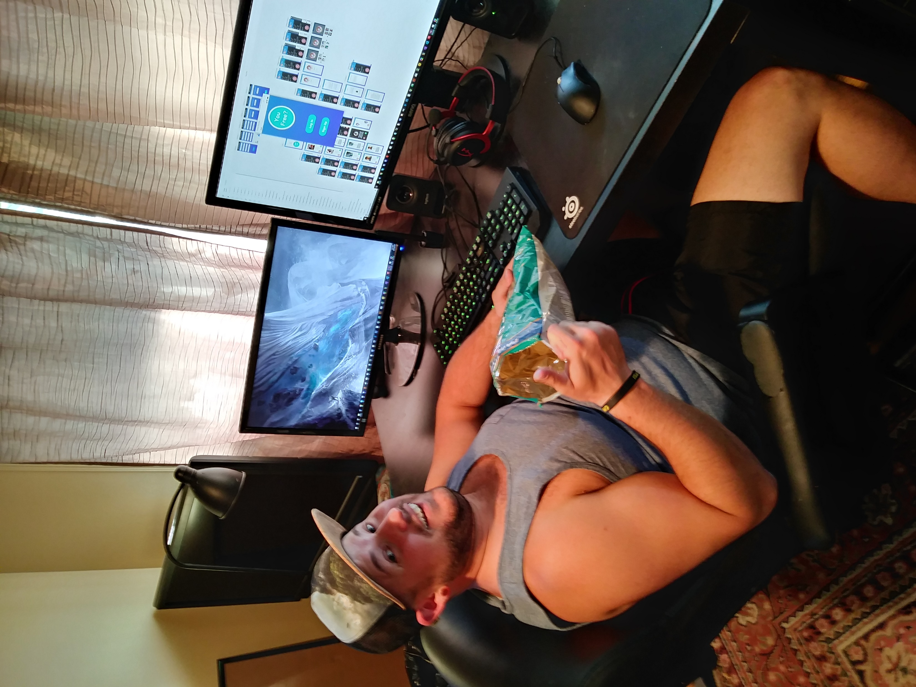
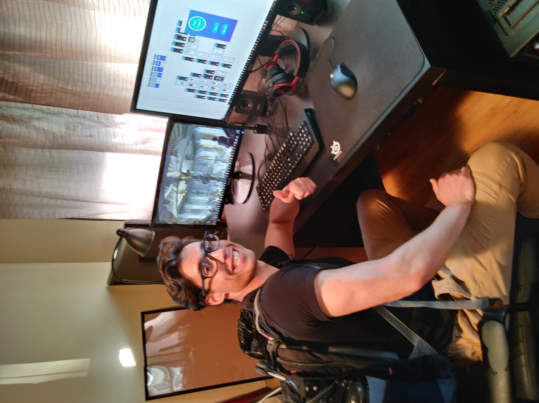
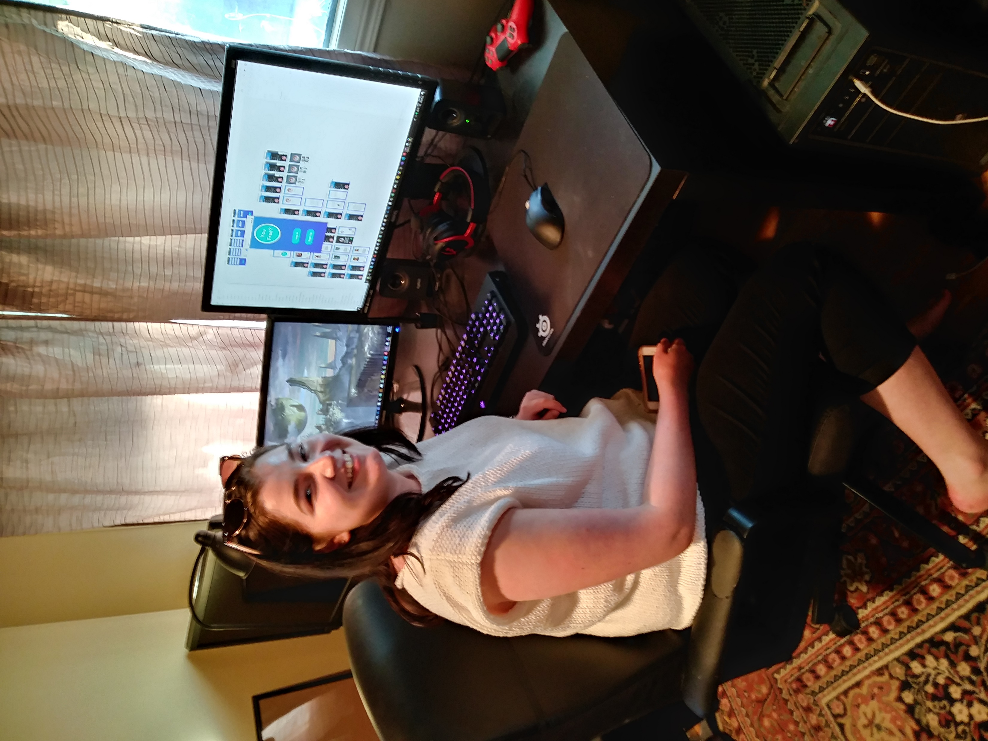
Test user Validity
Roommates!
Potential Bias?

Slide 11
Usability Techniques
Primarily “Think Aloud” Method
Ask each to perform 3 tasks
Time each task until complete
Test User explains their thoughts and reasoning
Brought them all back the next day to try it again (to test memorability)

Slide 12
Three Tasks
Log in and match with someone
Tell the app to stop searching, you’re out of spare time
Change your profile photo, then log out

Slide 13
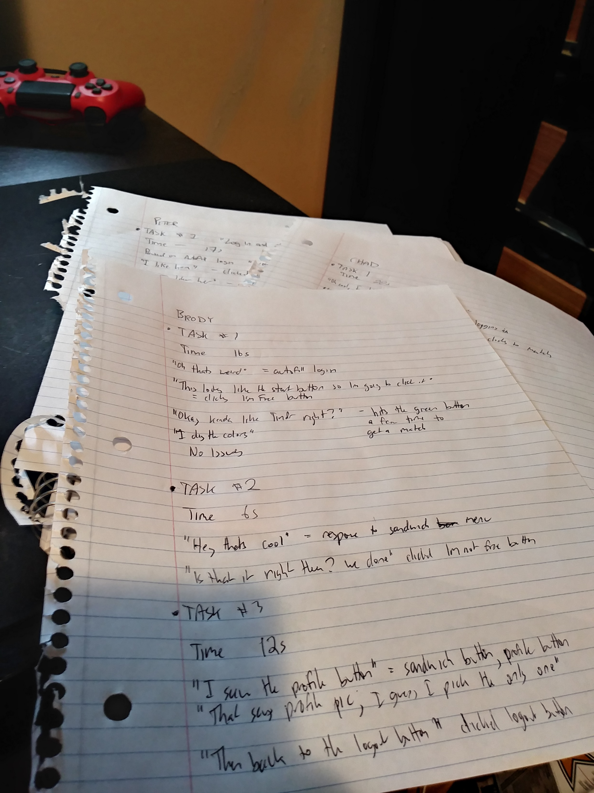
Three tasks
As they completed tasks, I wrote notes
Time for each task
Did they pause to think at any point?
Comments/Ideas
Signs of satisfaction/dissatisfaction

Slide 14
results
Learnability/Discoverability
Nearly every task completed on the first try – error free
Efficiency
As soon as they saw contents of sandwich menu, no issues

Slide 15
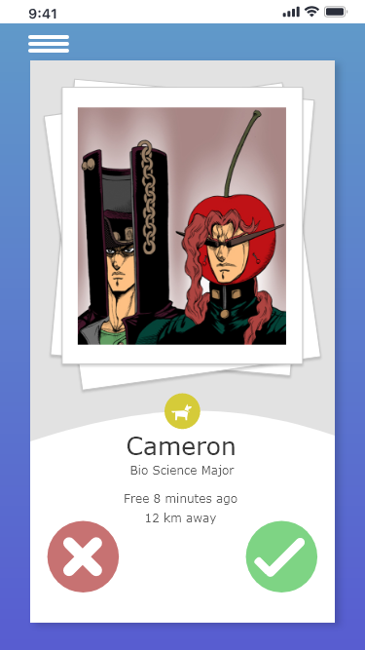
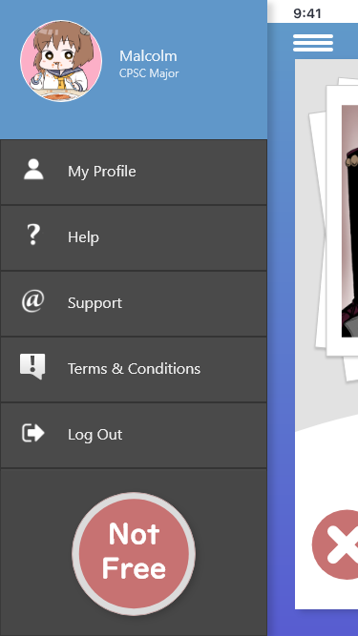
results
Memorability
Zero errors the second time around
Errors
Only one user error – Slip
The Profile Icon occupies the same space as the sandwich menu icon, when open can lead to accidental clicks and take you to the profile photo change and lose your place

Slide 16
results
Satisfaction
Liked the colour contrast with the greys
Sandwich menu felt snappy to use
Design Familiarity -- “It’s kinda like Tindr”

Slide 17
Other Discoveries
Log-In Screen and a Log-In Button, but no Create Account option?
Keyboard Autofill felt weird – Adobe XD limitation
Two Users match, where do they meet? Who moves?
Profile Photo changing should “last”
Profile Icon in sandwich menu could cause Slips

Slide 18
Hi-fi prototype changes
Add an Account Creation system
Add “Move” options in sandwich menu
Changing Profile Photos persist in an instance
Remove button functionality from Profile Icon

Slide 19
Future Iterations
Outgrown Adobe XD, switch to something that can import previous prototype
Add functional textboxes and proper keyboard interfacing
Add a basic database to store login credentials, at least for the instance
Allow the prototype to import outside photos to use for profile pic

Slide 20
Conclusion
Unique but rewarding challenge to work on a project solo,
balancing smaller scope with inclusion of many different
design approaches!
Thank You!

